Slide 1
Respiratory Illnesses
Strategies to Protect Yourself & Others This Respiratory Virus Season

Slide 2
What are respiratory illnesses?
Examples of Illnesses
  Flu
  COVID-19
  RSV
  Adenovirus
  Rhinovirus/Enterovirus (common cold)
  Parainfluenza
  Parvovirus B19 (Fifth Disease)
Examples of Symptoms
  Fever
  Chills
  Fatigue (tiredness)
  Cough
  Runny or stuffy nose
  Decrease in appetite
  Sore throat
  Vomiting
  New loss of taste or smell
  Headache, muscle or body aches
  Diarrhea
Respiratory viruses are viruses that cause illnesses in the respiratory system. These illnesses share similar symptoms, risk factors, and prevention strategies.

Slide 3
Flu, COVID-19, and RSV
Every year, respiratory viruses such as influenza (flu), COVID-19, and respiratory syncytial virus (RSV) cause hundreds of thousands of hospitalizations and thousands of deaths during the fall and winter virus season.
Fortunately, there are steps you can take to protect yourself and others against illness like staying up to date with the immunizations recommended for you:
  For most people that means getting a current flu and COVID-19 vaccine.
  Everyone ages 75 and older should get a respiratory syncytial virus (RSV) vaccine.
  CDC also recommends adults ages 50-74 who are at increased risk of severe RSV disease get an RSV vaccine.
Take steps to protect yourself and others against illness this fall and winter!

Slide 4
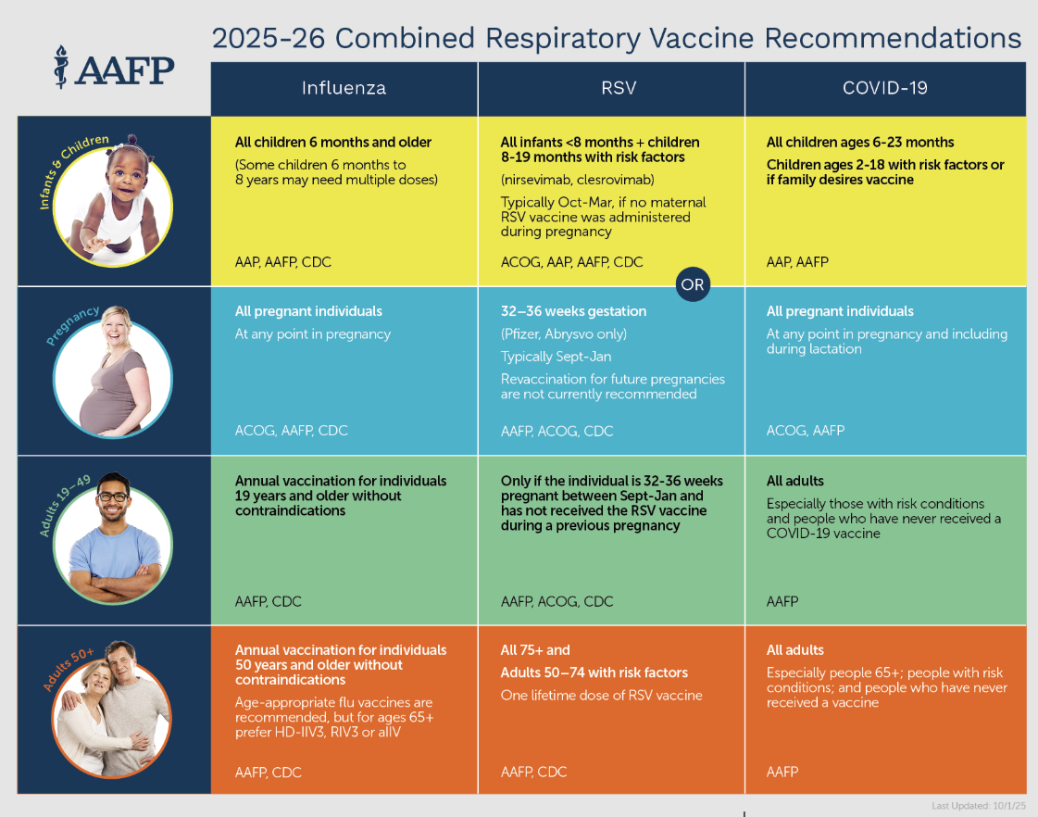

Slide 5
Layer Prevention Strategies
In addition to staying up to date with immunizations, these steps can help protect you, your loved ones and your colleagues:
  Practice good hygiene. Cover your coughs and sneezes, wash or sanitize your hands often, and clean high touch surfaces.
  Take steps for cleaner air. Bring in fresh outside air, purify indoor air, and consider gathering outdoors when possible.
  Prevent spread when you are sick. Stay home and away from others when you have respiratory virus symptoms like fever, cough, sore throat, and runny nose.
  Seek health care promptly if you have risk factors for severe illness. Early treatment may help lower your risk of severe illness.
  Consider additional strategies for further protection. Strategies like masking, physical distancing, and testing can help lower the risk of virus transmission when there is a lot of illness in your community.
Layering prevention strategies when there is a lot of illness circulating can be especially helpful!

Slide 6
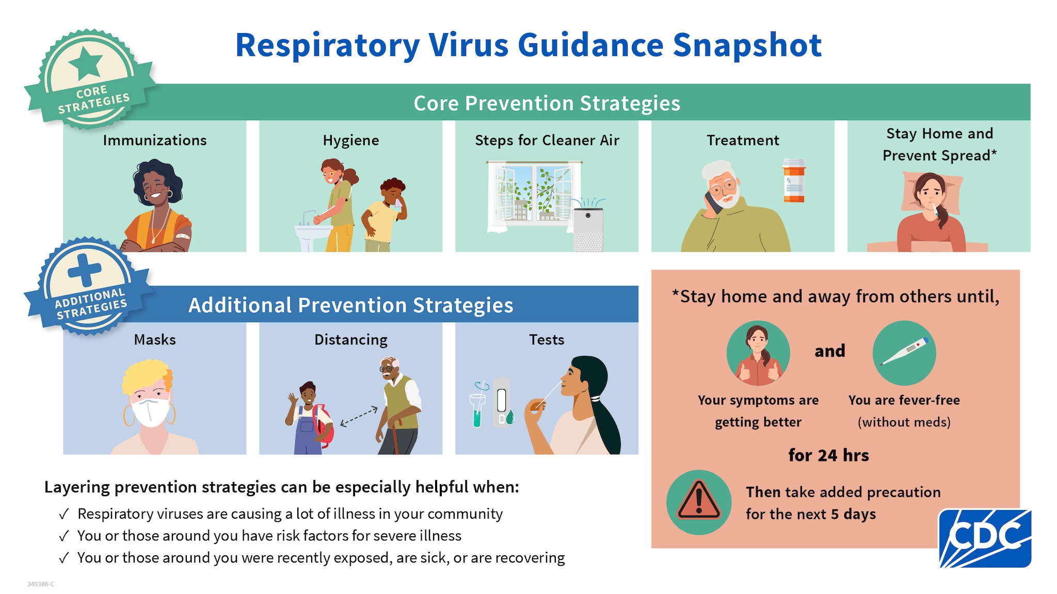

Slide 7
We Can Stay Healthy Together!
Additional respiratory virus guidance can be found in Ventegra’s Respiratory Illnesses Resource Center.
REPLACE LINK with location of information on your company intranet site if available.
Protect yourself, your loved ones, and your community by staying informed.

